Slide 1

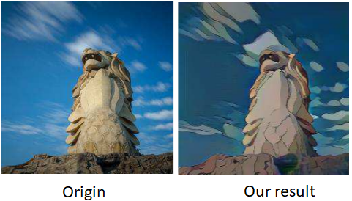
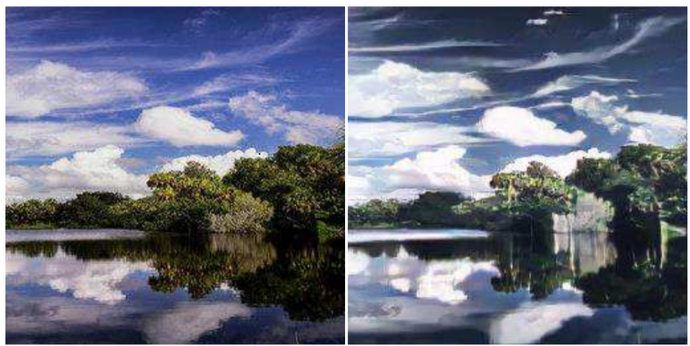
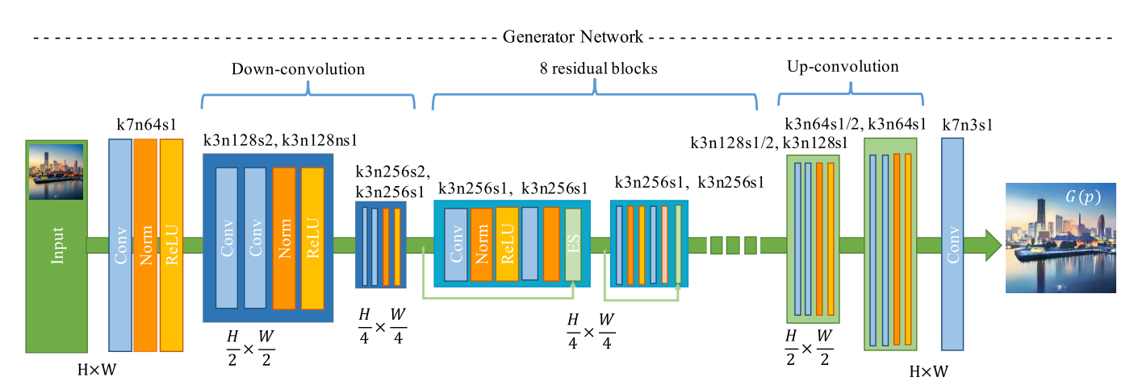
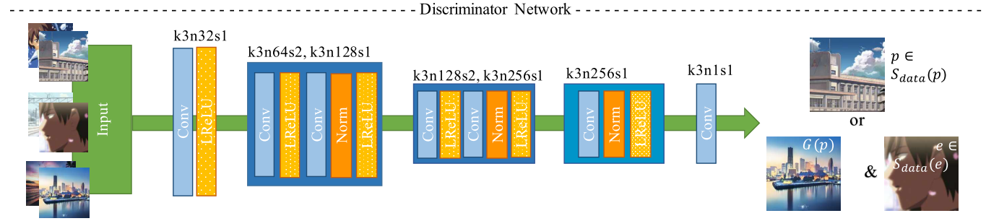
CartoonGAN: Generative Adversarial Networks for
Photo Cartoonization
Po-Yuan Lin
National Tsinghua University
Taiwan
Chien-Li Lu
National Chiao Tung University
Taiwan
Introduction
CartoonGAN propose a solution to transforming photos of real-
world scenes into cartoon style images, which is valuable and challenging in computer vision and computer graphics.
Cartoons are an artistic form widely used in our daily life
In addition to artistic interests, their applications range from
publication in printed media to storytelling for children’s education. Like other forms of artworks, many famous cartoon images were created based on real-world scenes.
Origin
Transfer to cartoon style
Network architecture
Loss function
Adversarial loss:
To drives the generator network to achieve the desired manifold transformation.
content loss:
To preserves the image content during cartoon stylization

